Slide 1
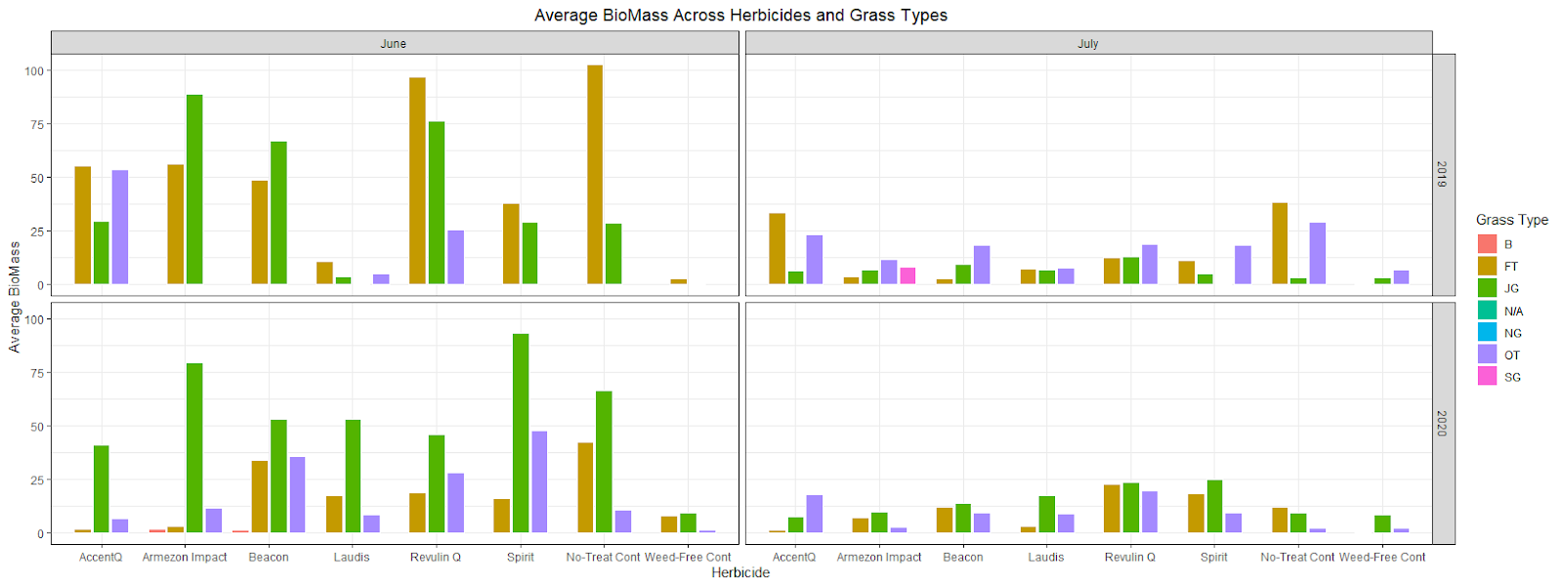
Friday Fun Days: Hands-on Experience and Peer Mentoring in a Master’s Level Consulting Course
Emily A. Robinson
Department of Statistics, University of Nebraska - Lincoln
Statistical Cross-Disciplinary Collaboration & Consulting Lab (SC3)
SC3L Consultants 4 Ph.D. Research Assistants Supervised by a tenured Director Communication with Clients Google form for initial client information Online scheduling assistant, Setmore Centralized SC3L email Communication between Consultants Weekly staff meetings Microsoft teams
Principles of Statistical Consulting (STAT 825)
Course Topics Asking good questions Dealing with difficult clients Communicating statistics to non-statisticians Mentor Role of SC3L Consultant Lead class activities one day a week Invite students to shadow client meetings
Advanced Statistical Consulting (STAT 930)
Course Structure Students collaborate with two to four clients of their own Weekly class meetings Mentor Role of SC3L Consultant Each SC3L consultant is paired with two students to serve as their mentor for the semester Mentor students on leading meetings, running analysis, and writing reports
‘Friday Fun Day’ Activities
Data Visualization Show & Tell Watch and discuss Advocating for data visualization video by Sharp, J.L., Griffith, E., and Higgs, M. (2020) Discuss how to create effective graphics for communication using Gestalt principles In class, students put the Gestalt principles into practice on a client data set Other Topics Effective Communication Challenges and Ethics Attitudes of Collaboration
Gestalt Principle | Graphic
Enclosure | Facets
Connection | Lines
Proximity | White Space
Similarity | Color/Shape
The SC3L is Hiring!
Assistant / Associate Professor - Director of Consulting
Student Sample Work

